Slide 1
PML Project* Summary
This summary focuses on the implementation in the 2-D serial code.
The Parallel 2-D and 3-D codes give similar results, so it’s probably not just a “random” bug in this one.
Here, we limit ourselves to the 1-D case of a uniform (along y) laser pulse moving in x.
Launching a radially moving wave from the center gives similar results.
I think that if we can get the 1-D pulse working, then I can get the radial wave to work too.
The paper by Vay I reference here is his 2000 JCP paper.
*AKA the scourge of my life in June and July.

Slide 2
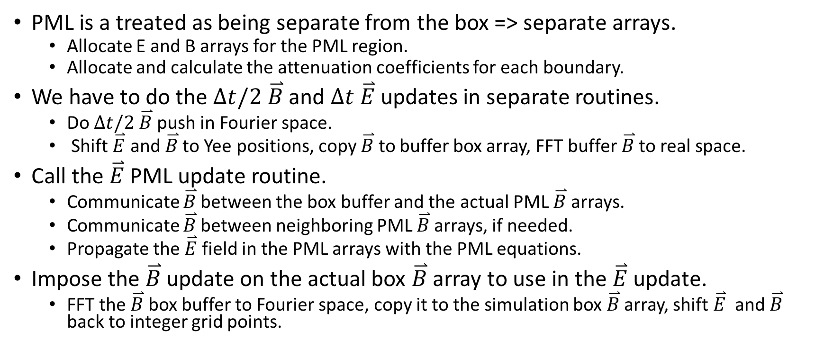
Ordering of the PML Routines in the Loop (1)
PML is a treated as being separate from the box => separate arrays.
Allocate E and B arrays for the PML region.
Allocate and calculate the attenuation coefficients for each boundary.
We have to do the $∆t/2$ $\overset{⃑}{B}$ and $∆t$ $\overset{⃑}{E}$ updates in separate routines.
Do $∆t/2$ $\overset{⃑}{B}$ push in Fourier space.
Shift $\overset{⃑}{E}$ and $\overset{⃑}{B}$ to Yee positions, copy $\overset{⃑}{B}$ to buffer box array, FFT buffer $\overset{⃑}{B}$ to real space.
Call the $\overset{⃑}{E}$ PML update routine.
Communicate $\overset{⃑}{B}$ between the box buffer and the actual PML $\overset{⃑}{B}$ arrays.
Communicate $\overset{⃑}{B}$ between neighboring PML $\overset{⃑}{B}$ arrays, if needed.
Propagate the $\overset{⃑}{E}$ field in the PML arrays with the PML equations.
Impose the $\overset{⃑}{B}$ update on the actual box $\overset{⃑}{B}$ array to use in the $\overset{⃑}{E}$ update.
FFT the $\overset{⃑}{B}$ box buffer to Fourier space, copy it to the simulation box $\overset{⃑}{B}$ array, shift $\overset{⃑}{E}$ and $\overset{⃑}{B}$ back to integer grid points.

Slide 3
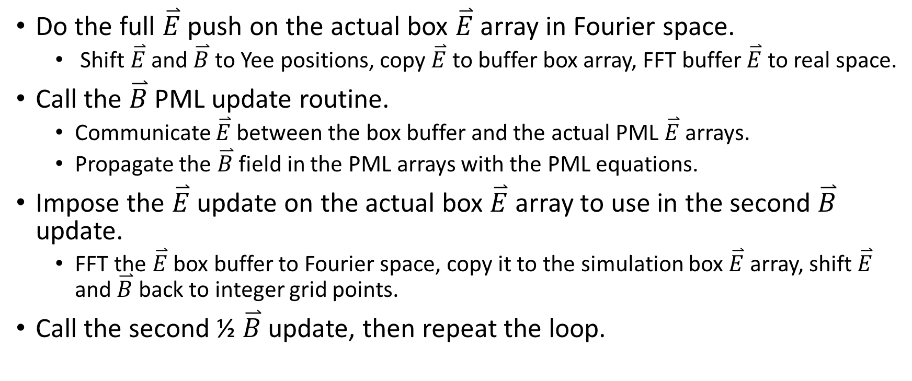
Ordering of the PML Routines in the Loop (2)
Do the full $\overset{⃑}{E}$ push on the actual box $\overset{⃑}{E}$ array in Fourier space.
Shift $\overset{⃑}{E}$ and $\overset{⃑}{B}$ to Yee positions, copy $\overset{⃑}{E}$ to buffer box array, FFT buffer $\overset{⃑}{E}$ to real space.
Call the $\overset{⃑}{B}$ PML update routine.
Communicate $\overset{⃑}{E}$ between the box buffer and the actual PML $\overset{⃑}{E}$ arrays.
Propagate the $\overset{⃑}{B}$ field in the PML arrays with the PML equations.
Impose the $\overset{⃑}{E}$ update on the actual box $\overset{⃑}{E}$ array to use in the second $\overset{⃑}{B}$ update.
FFT the $\overset{⃑}{E}$ box buffer to Fourier space, copy it to the simulation box $\overset{⃑}{E}$ array, shift $\overset{⃑}{E}$ and $\overset{⃑}{B}$ back to integer grid points.
Call the second ½ $\overset{⃑}{B}$ update, then repeat the loop.

Slide 4
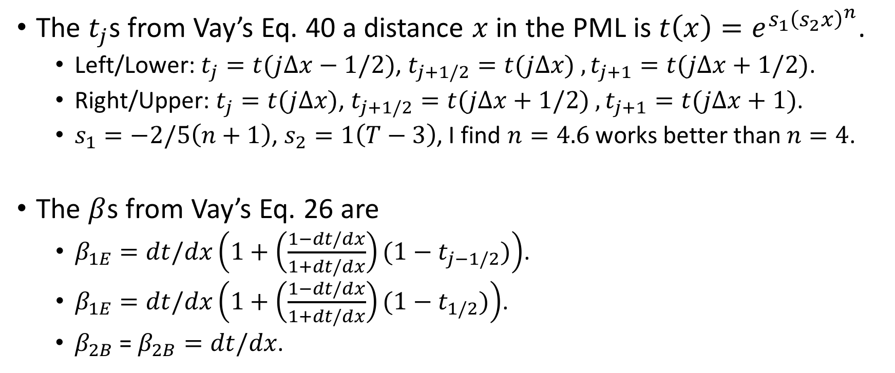
The attenuation coefficients are calculated from Vay’s paper (1)
The $t_{j}$s from Vay’s Eq. 40 a distance $x$ in the PML is $t\left(x\right)=e^{s_{1}{\left(s_{2}x\right)}^{n}}$.
Left/Lower: $t_{j}=t(j∆x−1/2)$, $t_{j+1/2}=t(j∆x)$ $,t_{j+1}=t(j∆x+1/2)$.
Right/Upper: $t_{j}=t(j∆x)$, $t_{j+1/2}=t(j∆x+1/2)$ $,t_{j+1}=t(j∆x+1)$.
$s_{1}=−2/5\left(n+1\right)$, $s_{2}=1\left(T−3\right)$, I find $n=4.6$ works better than $n=4$.
The $β$s from Vay’s Eq. 26 are
$β_{1E}=dt/dx\left(1+\left(\frac{1−dt/dx}{1+dt/dx}\right)(1−t_{j−1/2})\right)$.
$β_{1E}=dt/dx\left(1+\left(\frac{1−dt/dx}{1+dt/dx}\right)(1−t_{1/2})\right)$.
$β_{2B}$ = $β_{2B}=dt/dx$.

Slide 5
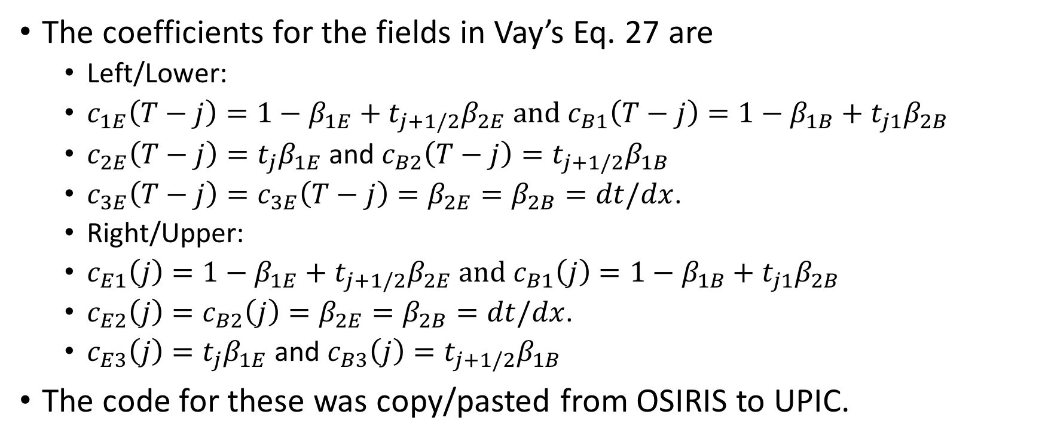
The attenuation coefficients are calculated from Vay’s paper (2)
The coefficients for the fields in Vay’s Eq. 27 are
Left/Lower:
$c_{1E}\left(T−j\right)=1−β_{1E}+t_{j+1/2}β_{2E}$ and $c_{B1}\left(T−j\right)=1−β_{1B}+t_{j1}β_{2B}$
$c_{2E}\left(T−j\right)=t_{j}β_{1E}$ and $c_{B2}\left(T−j\right)=t_{j+1/2}β_{1B}$
$c_{3E}\left(T−j\right)=c_{3E}\left(T−j\right)=β_{2E}=β_{2B}=dt/dx$.
Right/Upper:
$c_{E1}\left(j\right)=1−β_{1E}+t_{j+1/2}β_{2E}$ and $c_{B1}\left(j\right)=1−β_{1B}+t_{j1}β_{2B}$
$c_{E2}\left(j\right)=c_{B2}\left(j\right)=β_{2E}=β_{2B}=dt/dx$.
$c_{E3}\left(j\right)=t_{j}β_{1E}$ and $c_{B3}\left(j\right)=t_{j+1/2}β_{1B}$
The code for these was copy/pasted from OSIRIS to UPIC.

Slide 6
The PML Overlaps with the Actual Simulation Box
This is to comply with the periodic FFT.
Whole PML is copied to box.
Loop ranges to the standard Yee solver and attenuation regions are slightly different than in OSIRIS.
Yes, that is a bug in the loop range on the right side in B.
Shouldn't’t matter when thickness is large.
x only | * * * * * * * | Yee |  |  |  | copy to PML
 | +-+-+-+-+- | Waves moving in x attenuated |  |  |  | copy to box
E | ++++++++ | Yee & waves moving in x attenuated
* * * * * * * | ++++++++ | ++++++++ | ++++++++ |  |  |  |  |  |  |  |  | ++++++++ | ++++++++ | ++++++++ | ++++++++
* * * * * * * | ++++++++ | ++++++++ | ++++++++ |  |  |  |  |  |  |  |  | ++++++++ | ++++++++ | ++++++++ | ++++++++
* * * * * * * | ++++++++ | ++++++++ | ++++++++ |  |  |  |  |  |  |  |  | ++++++++ | ++++++++ | ++++++++ | ++++++++
* * * * * * * | ++++++++ | ++++++++ | ++++++++ |  |  |  |  |  |  |  |  | ++++++++ | ++++++++ | ++++++++ | ++++++++
* * * * * * * | ++++++++ | ++++++++ | ++++++++ |  |  |  |  |  |  |  |  | ++++++++ | ++++++++ | ++++++++ | ++++++++
* * * * * * * | ++++++++ | ++++++++ | ++++++++ |  |  |  |  |  |  |  |  | ++++++++ | ++++++++ | ++++++++ | ++++++++
* * * * * * * | ++++++++ | ++++++++ | ++++++++ |  |  |  |  |  |  |  |  | ++++++++ | ++++++++ | ++++++++ | ++++++++
* * * * * * * | ++++++++ | ++++++++ | ++++++++ |  |  |  |  |  |  |  |  | ++++++++ | ++++++++ | ++++++++ | ++++++++
* * * * * * * | ++++++++ | ++++++++ | ++++++++ |  |  |  |  |  |  |  |  | ++++++++ | ++++++++ | ++++++++ | ++++++++
* * * * * * * | ++++++++ | ++++++++ | ++++++++ |  |  |  |  |  |  |  |  | ++++++++ | ++++++++ | ++++++++ | ++++++++
* * * * * * * | ++++++++ | ++++++++ | ++++++++ |  |  |  |  |  |  |  |  | ++++++++ | ++++++++ | ++++++++ | ++++++++
* * * * * * * | ++++++++ | ++++++++ | ++++++++ |  |  |  |  |  |  |  |  | ++++++++ | ++++++++ | ++++++++ | ++++++++
* * * * * * * | ++++++++ | ++++++++ | ++++++++ |  |  |  |  |  |  |  |  | ++++++++ | ++++++++ | ++++++++ | ++++++++
* * * * * * * | ++++++++ | ++++++++ | ++++++++ |  |  |  |  |  |  |  |  | ++++++++ | ++++++++ | ++++++++ | ++++++++
* * * * * * * | ++++++++ | ++++++++ | ++++++++ |  |  |  |  |  |  |  |  | ++++++++ | ++++++++ | ++++++++ | ++++++++
 | +-+-+-+-+- | +-+-+-+-+- | +-+-+-+-+- |  |  |  |  |  |  |  |  | +-+-+-+-+- | +-+-+-+-+- | +-+-+-+-+- | +-+-+-+-+-
B
+-+-+-+-+- | +-+-+-+-+- | +-+-+-+-+- | +-+-+-+-+- |  |  |  |  |  |  |  |  | +-+-+-+-+- | +-+-+-+-+-
++++++++ | ++++++++ | ++++++++ | ++++++++ |  |  |  |  |  |  |  |  | ++++++++ | ++++++++ | * * * * * * *
++++++++ | ++++++++ | ++++++++ | ++++++++ |  |  |  |  |  |  |  |  | ++++++++ | ++++++++ | * * * * * * *
++++++++ | ++++++++ | ++++++++ | ++++++++ |  |  |  |  |  |  |  |  | ++++++++ | ++++++++ | * * * * * * *
++++++++ | ++++++++ | ++++++++ | ++++++++ |  |  |  |  |  |  |  |  | ++++++++ | ++++++++ | * * * * * * *
++++++++ | ++++++++ | ++++++++ | ++++++++ |  |  |  |  |  |  |  |  | ++++++++ | ++++++++ | * * * * * * *
++++++++ | ++++++++ | ++++++++ | ++++++++ |  |  |  |  |  |  |  |  | ++++++++ | ++++++++ | * * * * * * *
++++++++ | ++++++++ | ++++++++ | ++++++++ |  |  |  |  |  |  |  |  | ++++++++ | ++++++++ | * * * * * * *
++++++++ | ++++++++ | ++++++++ | ++++++++ |  |  |  |  |  |  |  |  | ++++++++ | ++++++++ | * * * * * * *
++++++++ | ++++++++ | ++++++++ | ++++++++ |  |  |  |  |  |  |  |  | ++++++++ | ++++++++ | * * * * * * *
++++++++ | ++++++++ | ++++++++ | ++++++++ |  |  |  |  |  |  |  |  | ++++++++ | ++++++++ | * * * * * * *
++++++++ | ++++++++ | ++++++++ | ++++++++ |  |  |  |  |  |  |  |  | ++++++++ | ++++++++ | * * * * * * *
++++++++ | ++++++++ | ++++++++ | ++++++++ |  |  |  |  |  |  |  |  | ++++++++ | ++++++++ | * * * * * * *
++++++++ | ++++++++ | ++++++++ | ++++++++ |  |  |  |  |  |  |  |  | ++++++++ | ++++++++ | * * * * * * *
++++++++ | ++++++++ | ++++++++ | ++++++++ |  |  |  |  |  |  |  |  | ++++++++ | ++++++++ | * * * * * * *
++++++++ | ++++++++ | ++++++++ | ++++++++ |  |  |  |  |  |  |  |  | ++++++++ | ++++++++ | * * * * * * *

Slide 7
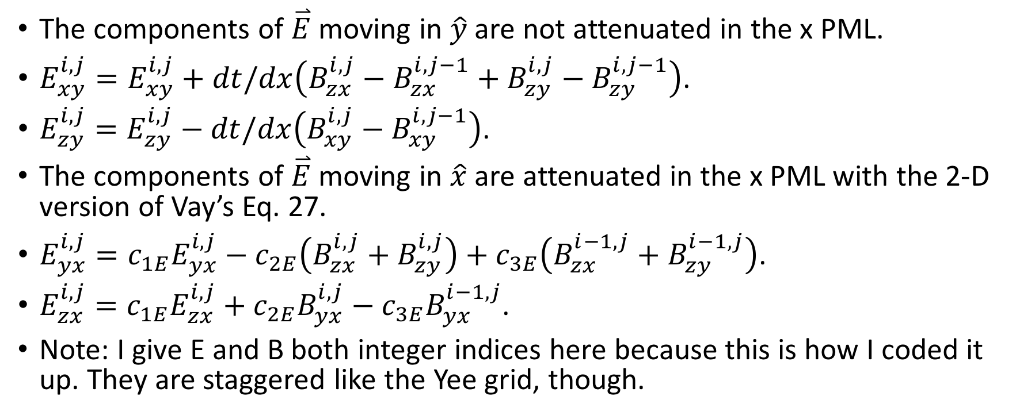
The Field Push Equations Come from the standard Yee solver and Vay’s Paper
The components of $\overset{⃑}{E}$ moving in $\hat{y}$ are not attenuated in the x PML.
$E_{xy}^{i,j}=E_{xy}^{i,j}+dt/dx\left(B_{zx}^{i,j}−B_{zx}^{i,j−1}+B_{zy}^{i,j}−B_{zy}^{i,j−1}\right)$.
$E_{zy}^{i,j}=E_{zy}^{i,j}−dt/dx\left(B_{xy}^{i,j}−B_{xy}^{i,j−1}\right)$.
The components of $\overset{⃑}{E}$ moving in $\hat{x}$ are attenuated in the x PML with the 2-D version of Vay’s Eq. 27.
$E_{yx}^{i,j}=c_{1E}E_{yx}^{i,j}−c_{2E}\left(B_{zx}^{i,j}+B_{zy}^{i,j}\right)+c_{3E}\left(B_{zx}^{i−1,j}+B_{zy}^{i−1,j}\right)$.
$E_{zx}^{i,j}=c_{1E}E_{zx}^{i,j}+c_{2E}B_{yx}^{i,j}−c_{3E}B_{yx}^{i−1,j}$.
Note: I give E and B both integer indices here because this is how I coded it up. They are staggered like the Yee grid, though.

Slide 8
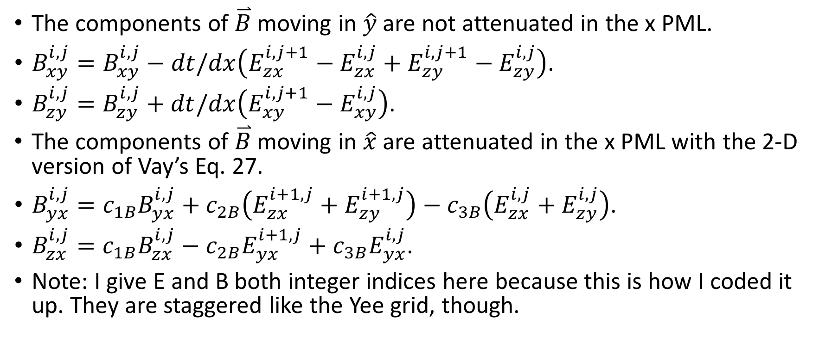
The Field Push Equations Come from the standard Yee solver and Vay’s Paper
The components of $\overset{⃑}{B}$ moving in $\hat{y}$ are not attenuated in the x PML.
$B_{xy}^{i,j}=B_{xy}^{i,j}−dt/dx\left(E_{zx}^{i,j+1}−E_{zx}^{i,j}+E_{zy}^{i,j+1}−E_{zy}^{i,j}\right)$.
$B_{zy}^{i,j}=B_{zy}^{i,j}+dt/dx\left(E_{xy}^{i,j+1}−E_{xy}^{i,j}\right)$.
The components of $\overset{⃑}{B}$ moving in $\hat{x}$ are attenuated in the x PML with the 2-D version of Vay’s Eq. 27.
$B_{yx}^{i,j}=c_{1B}B_{yx}^{i,j}+c_{2B}\left(E_{zx}^{i+1,j}+E_{zy}^{i+1,j}\right)−c_{3B}\left(E_{zx}^{i,j}+E_{zy}^{i,j}\right)$.
$B_{zx}^{i,j}=c_{1B}B_{zx}^{i,j}−c_{2B}E_{yx}^{i+1,j}+c_{3B}E_{yx}^{i,j}$.
Note: I give E and B both integer indices here because this is how I coded it up. They are staggered like the Yee grid, though.

Slide 9
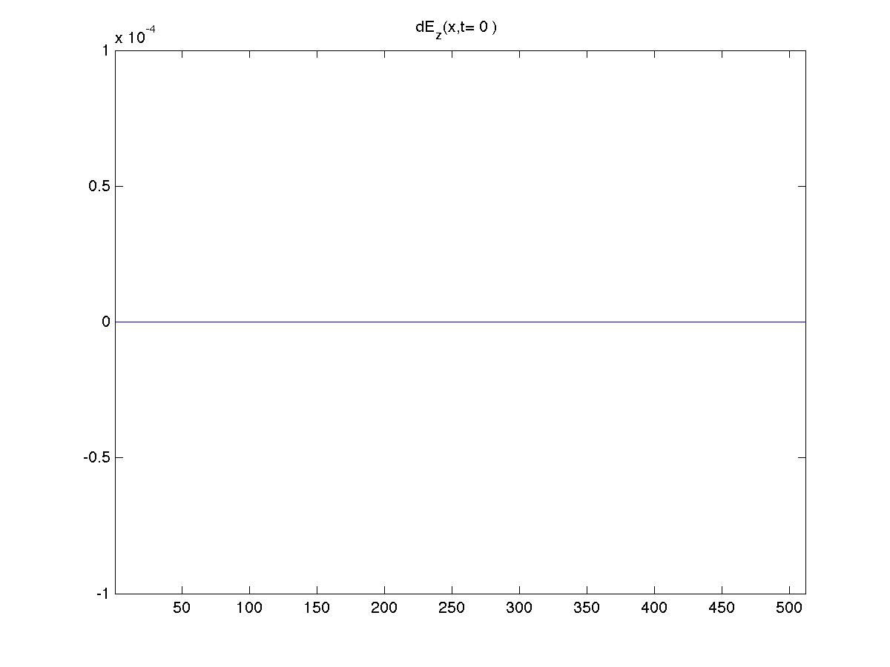
Using 20 PML Cells Results In Partial Attenuation
dEz is calculated from the difference between a wave moving in a 512 cell box with 20 PML cells (493-512) and a 1024 box with no PML (“perfectly absorbing”).

Slide 10
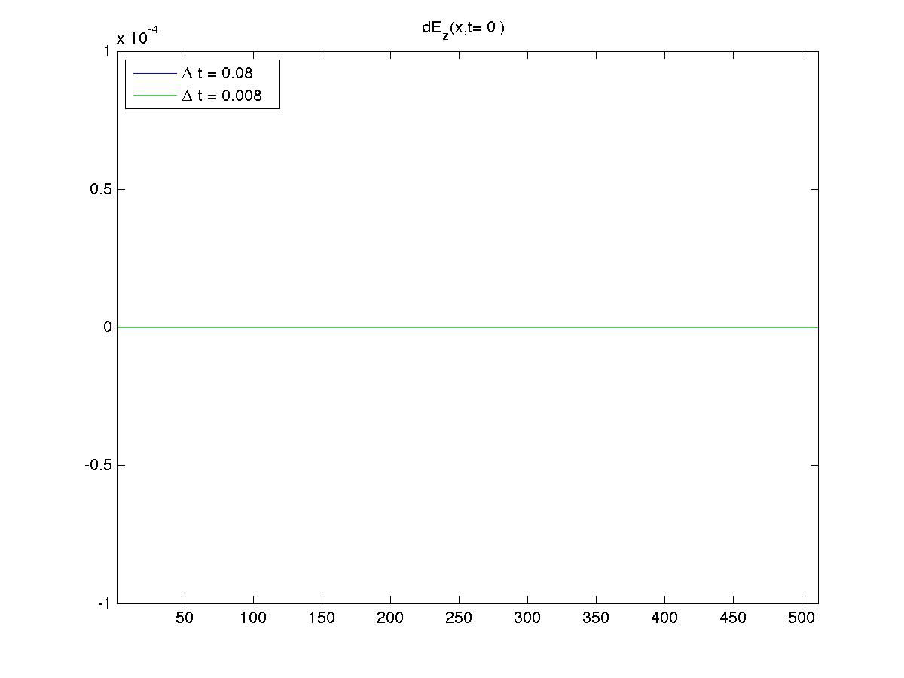
Reducing the Time Step Results in Roughly the Same Results

Slide 11
END

Slide 12
The PML Arrays Overlay the Simulation Box
Everywhere except the red cells are copied to the box.
It’s actually a bug that a whole column is being copied to the x PML, but it gets overwritten by the y PML right away so I guess it doesn’t matter..
 |  |  |  | whole column |  |  |  |  |  |  | whole column
 |  |  | copy to y | copy to x |  |  |  |  |  |  | copy to x | copy to y
 |  |  |  | copy to x&y |  |  |  |  |  |  | copy to x&y
 |  |  |  | copy to x&y |  |  |  |  |  |  | copy to x&y

